Slide 2
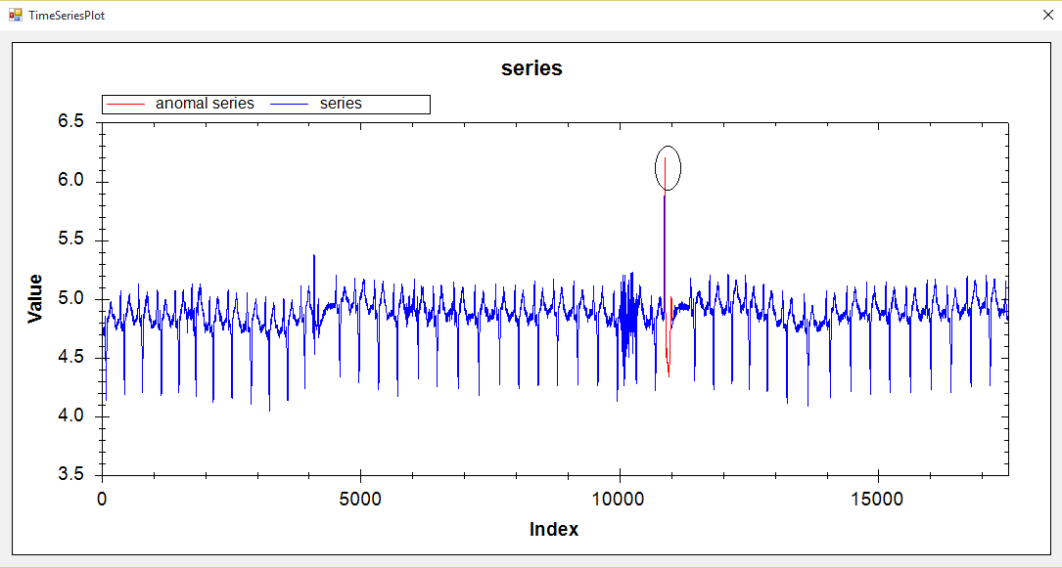
ECG 108 / VL_QR|HT

Slide 3
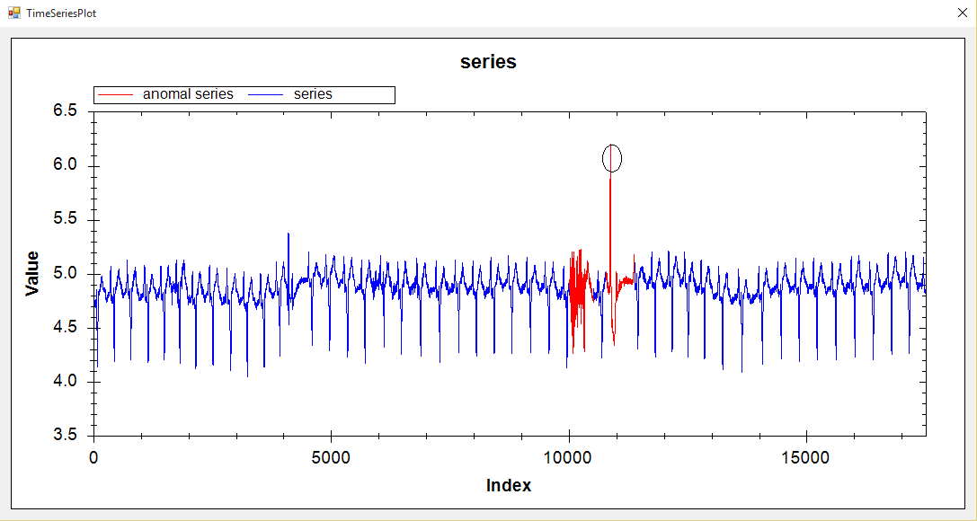
ECG 108 / VL_EP|HT

Slide 4
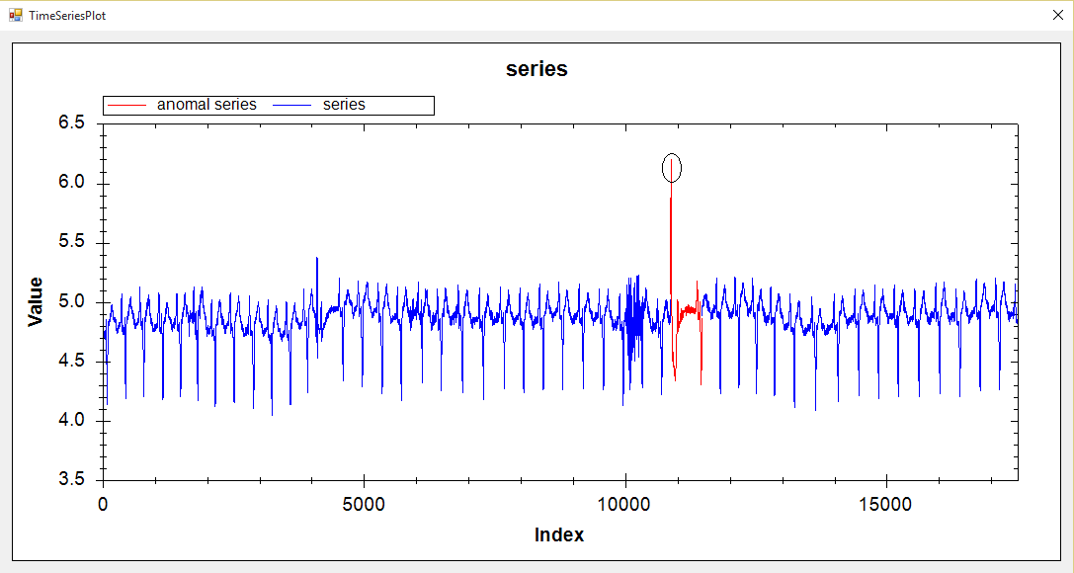
ECG 108 /HOT SAX

Slide 5
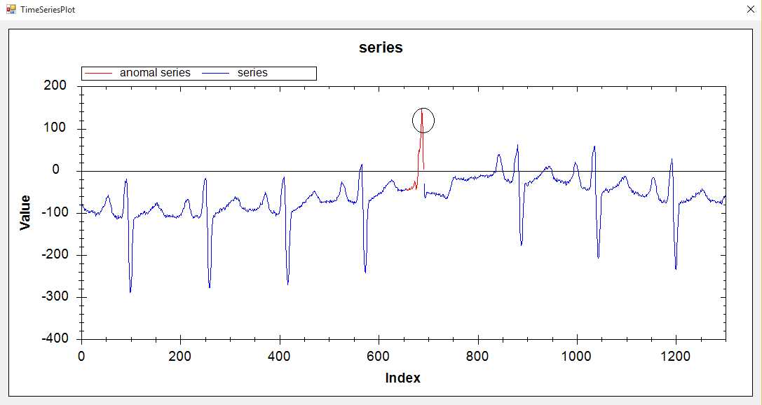
ECG 308 /VL_QR | HT

Slide 6
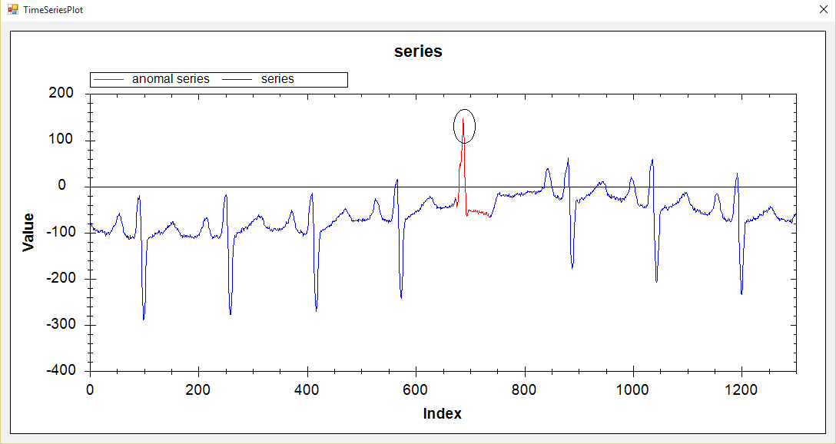
ECG 308 /VL_EP | HT

Slide 7
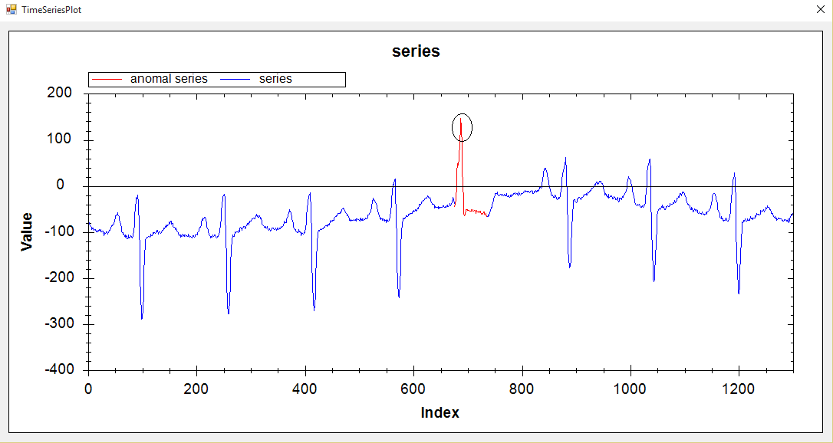
ECG 308 /HOT SAX

Slide 8
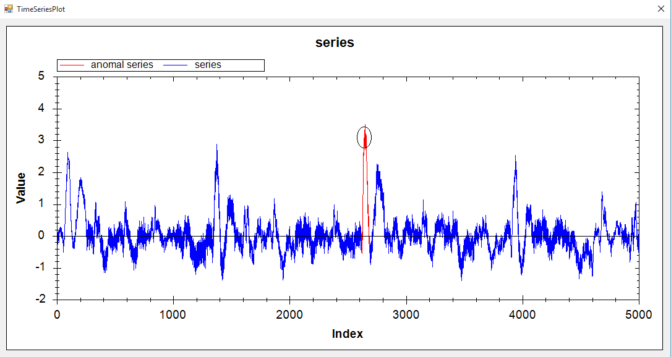
ERP / VL_QR |HT

Slide 9
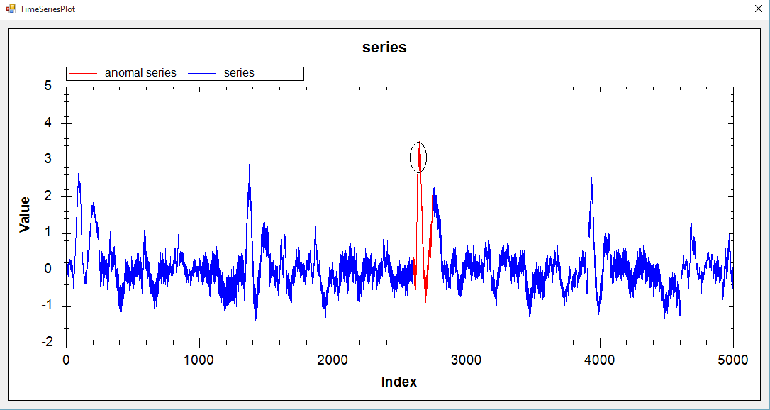
ERP / VL_EP | HT

Slide 10
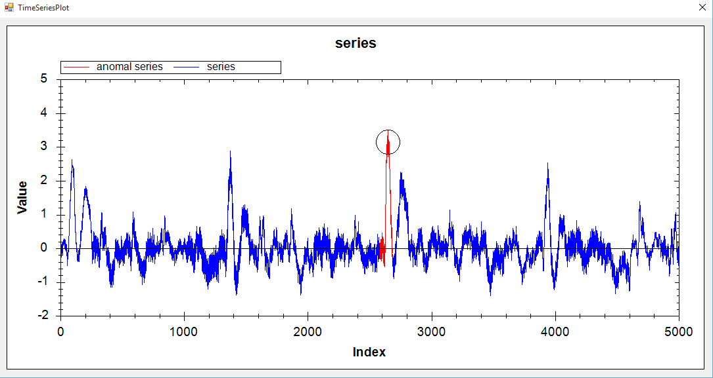
ERP / HOT SAX

Slide 11
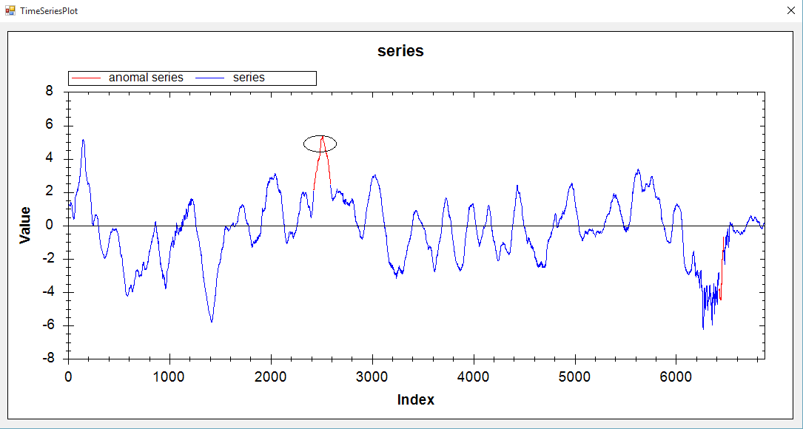
Memory/ VL_QR | HT

Slide 12
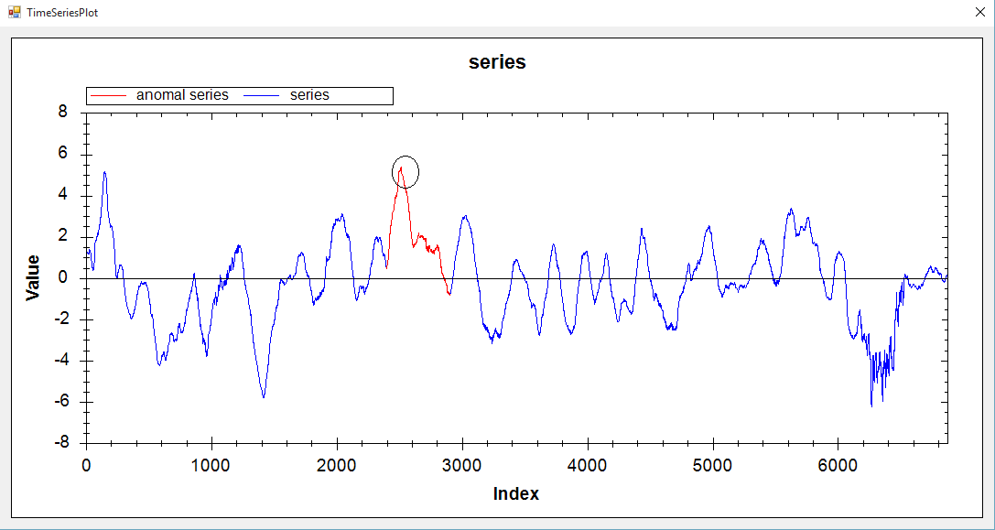
Memory/ VL_EP | HT

Slide 13
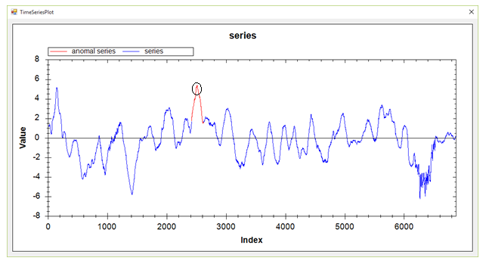
Memory/ HOT SAX

Slide 14
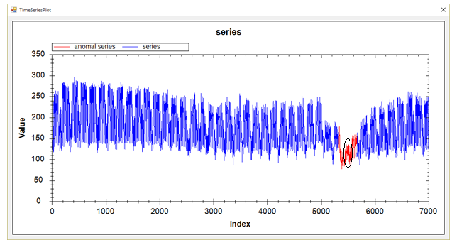
Power Demand In Italy/ VL_QR|HT

Slide 15
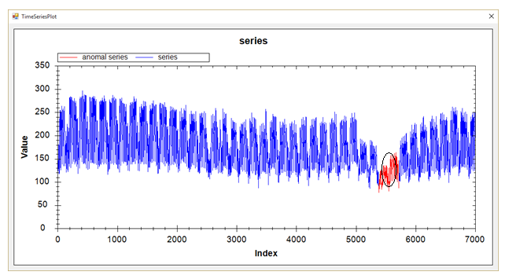
Power Demand In Italy/ VL_EP|HT

Slide 16

Power Demand In Italy/ HOT SAX

Slide 17
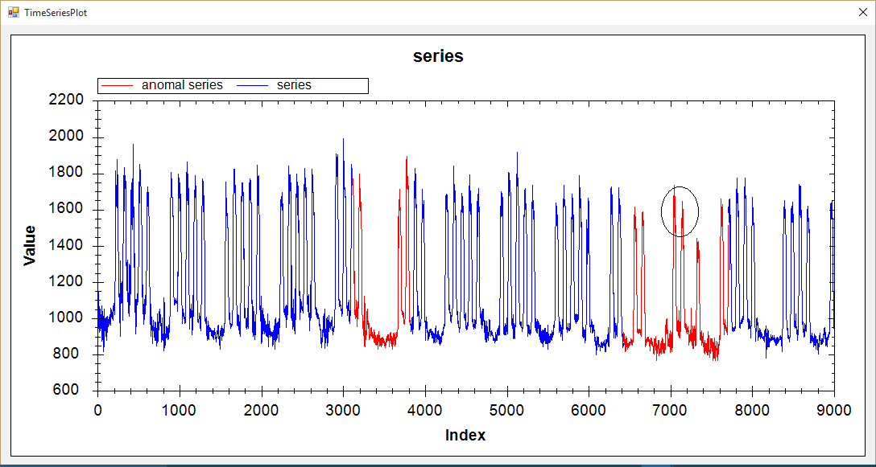
Dutch Power Demand/ VL_QR | HT

Slide 18
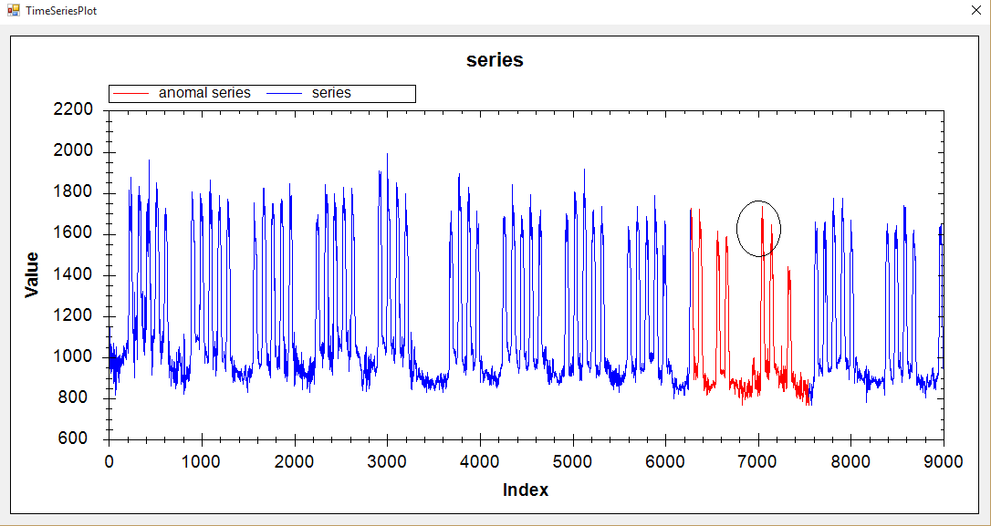
Dutch Power Demand/ VL_EP | HT

Slide 19
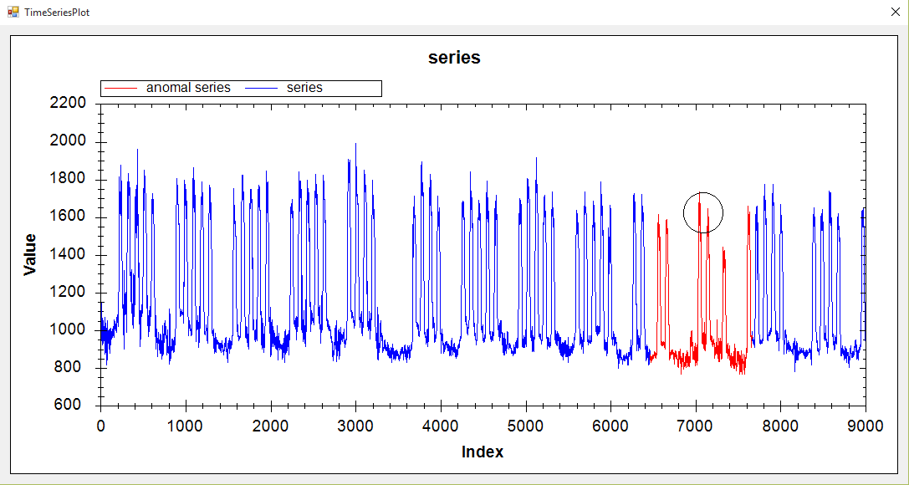
Dutch Power Demand/ HOT SAX

Slide 20
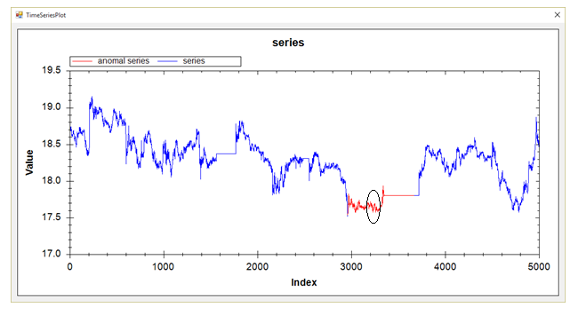
Stock20/ VL_QR | HT

Slide 21
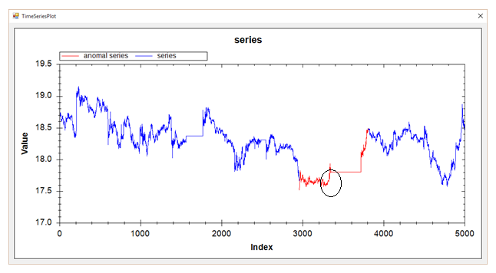
Stock20/ VL_EP | HT

Slide 22
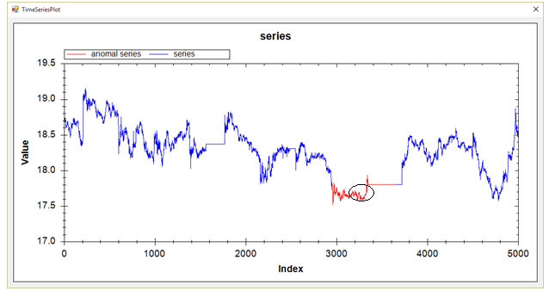
Stock20/ HOT SAX

Slide 23
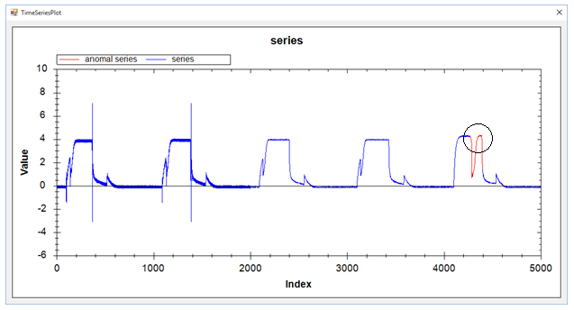
TEK16/ VL_QR | HT

Slide 24
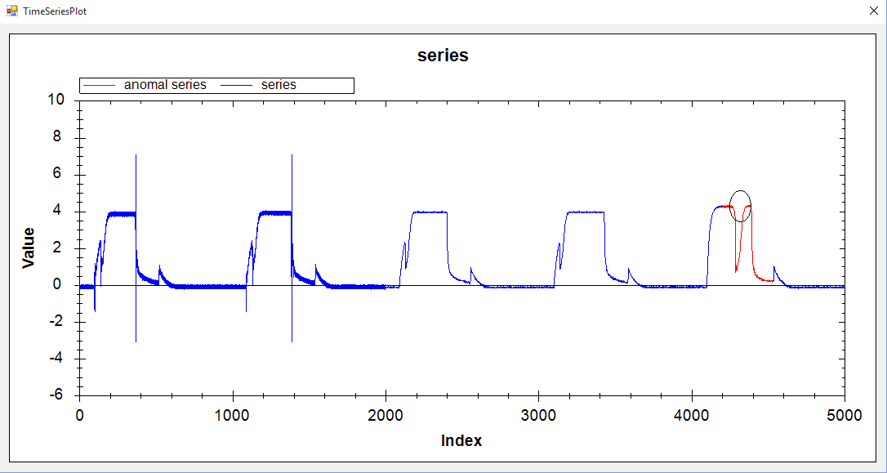
TEK16/ VL_EP | HT

Slide 25
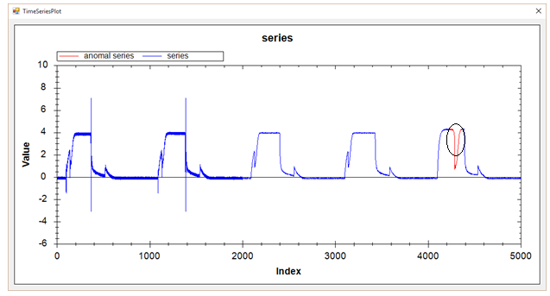
TEK16/ HOT SAX

